Slide 1

IST 718 – M003 Malware Detection on Microsoft Systems
Group 4:
Pranav RadhaKrishna
Prankur Garg
Tejas Patil
Sarthak Tandon

Slide 2

Problem Statement
Malware is any software intentionally designed to cause damage to any computer, server, client or computer network.
It exploits security defects in the design of operating system, in applications or in vulnerable versions of browser plugins.
For preventing such instances happening in future, it is utmost important to find out whether the computer is infected or how likely it will get infected in the future and take preventive measures accordingly.

Slide 3
Data Set & Project Description
The dataset contains 82 independent assessment parameters which are a mix of categorical and numerical type and has 700,000 rows.
The target variable ‘HasDetections’ is a binary attribute indicating whether that machine was infected by malware or not.
Link to the dataset: Microsoft Malware Detection Dataset
The dataset contains the information about different machines with windows operating systems and their attributes that will help in determining the likelihood of that machine getting infected by malware.
The aim of this project it to determine a model which will help determining how likely a machine is likely to get infected

Slide 4


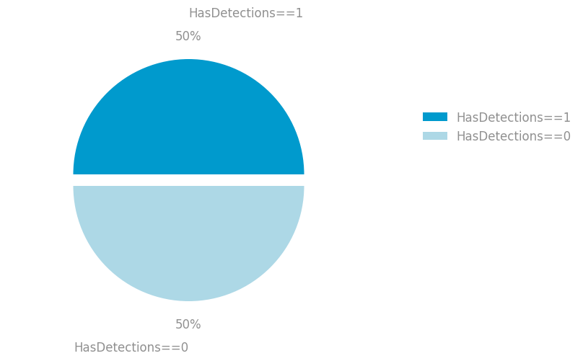

Slide 5
Data Preprocessing
Removing columns with >50% missing values
Removing columns with >90% similar values
Imputing missing values and removing outliers
Redistributing the categories
Removing rows with < 5% missing values
Aligning Datatypes
Feature importance
Encoding
Rows: 700000
Columns: 83
Rows: 655319; Columns: 56
Rows: 655319; Columns: 53000+
Rows: 655319
Columns: 20

Slide 6
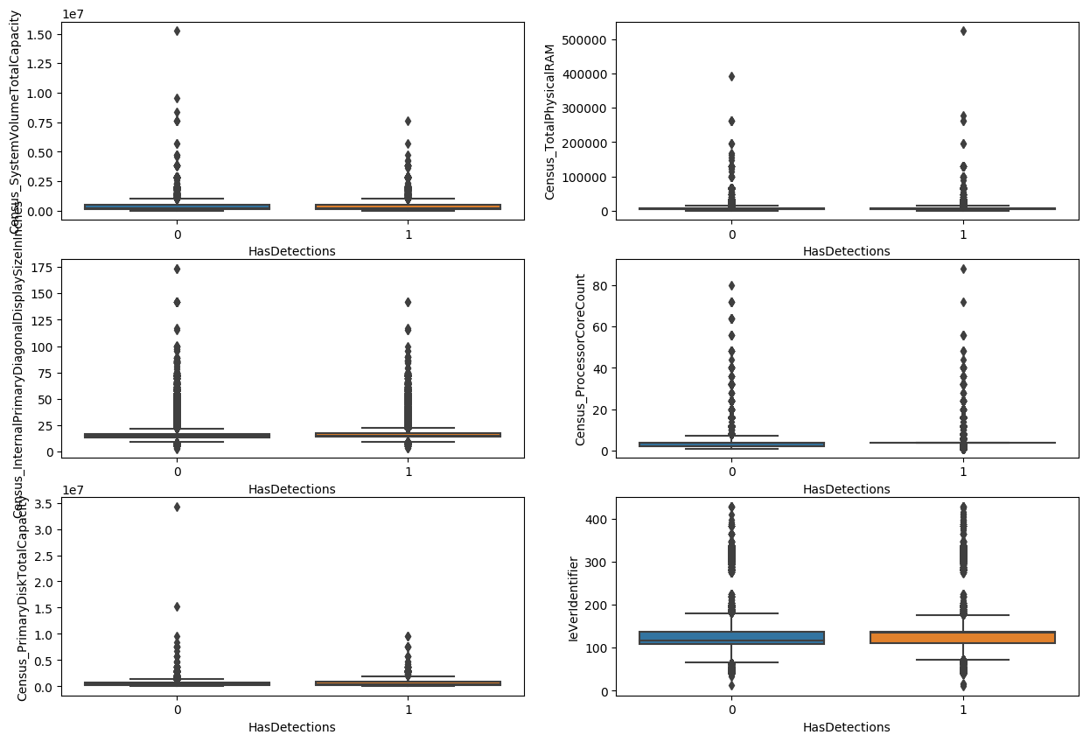
The boxplots show that outliers exist and winsorizing the data is necessary

Slide 7
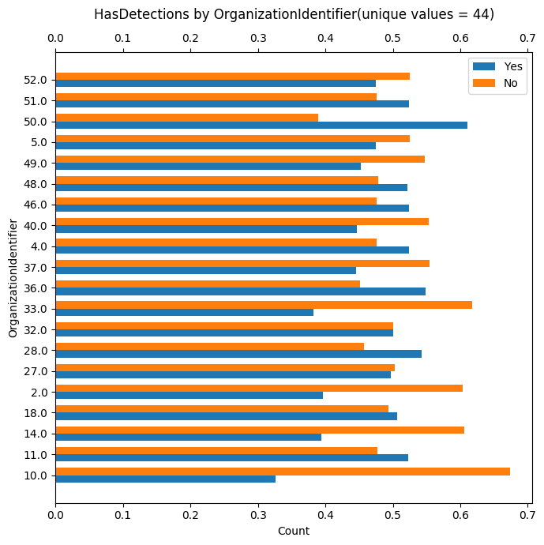
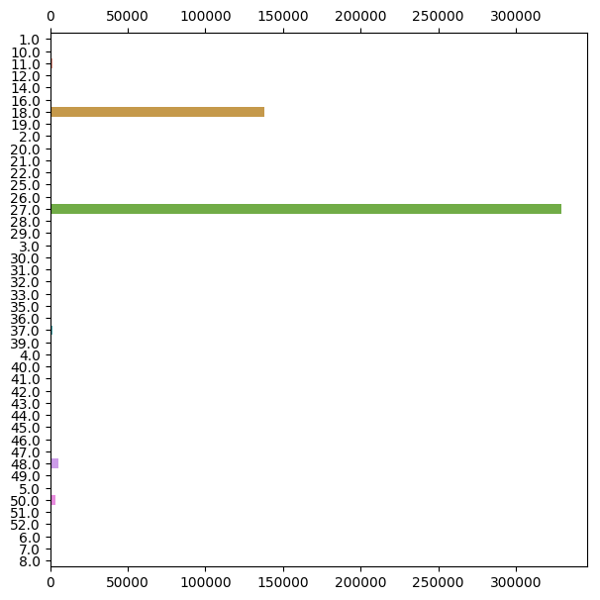
These chart show that though the distribution of target variable is diverse in each category of the column, two category predominate. Hence grouping is needed.

Slide 8
ML MODELS AND RESULTS
We ran the following models on our training data:
Decision Tree
Naïve Bayes Classifier
Logistic Regression
Random Forest
Gradient Boosting

Slide 9
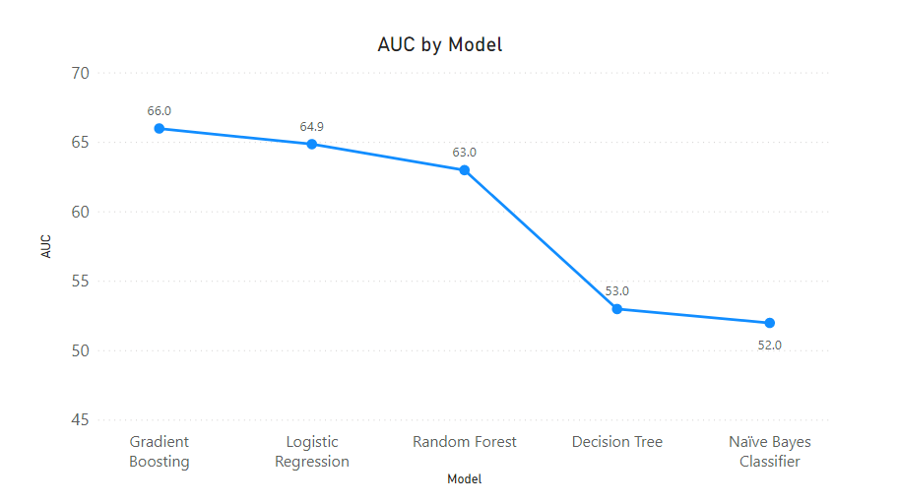

Slide 10
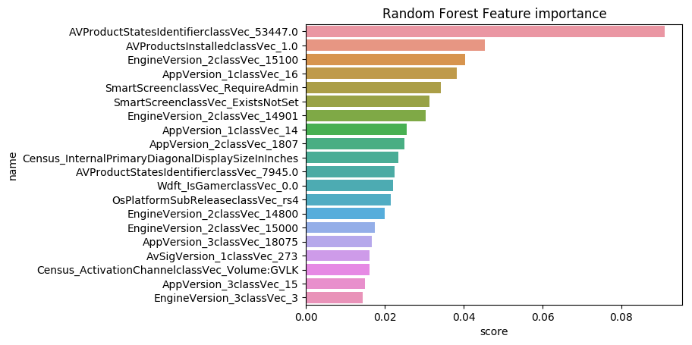

Slide 11
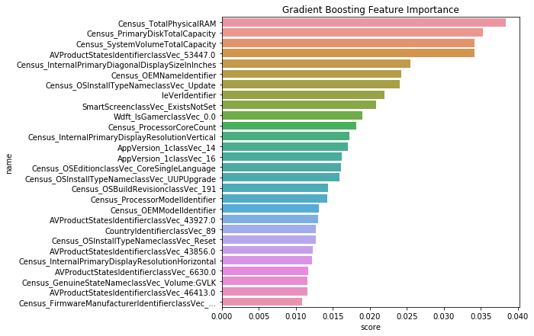

Slide 12
Problems Encountered
Size of the data
Proper Representation of the main data
High number of Categories in certain features
Handling Outliers
High Volume of NaN Values.
Algorithm Execution

Slide 13

Project Work Distribution
 | Data Preprocessing | Random Forest | Logistic Regression | Naïve Bayes | Decision Tree | Gradient Boosting
Pranav Radhakrishna
Tejas Patil
Prankur Garg
Sarthak Tandon

Slide 14

Thank You

